Slide 1
DS RESEARCH “Important Notes”
TOPICS:
1. Node Garbage Collector
2. Multi Attribute Tree Adapter
3. Indexed Struct

Slide 2
NODE GARBAGE COLLECTOR

Slide 3
Background:-
What is it? It’s a simple stack of SLL/DLL/AVL/BST etc nodes (means u can implement it in any node class)
Why Stack? Gives O(1) time-complexity for push & pop (i.e. to transfer nodes, instead of deleting them)
Why Implemented? To reduce OS overhead since we have to continuously request for allocation/deallocation (using new/delete etc)

Slide 4
Today’s Discussion (GC of DLL>SLL):-
In Doubly linked list class, this Garbage Collector works even more efficiently as each time a node-class object of a type gets destroyed, its’ nodes are transferred to Garbage Collector at O(1) Complexity, whereas in Singly, its O(n).

Slide 5
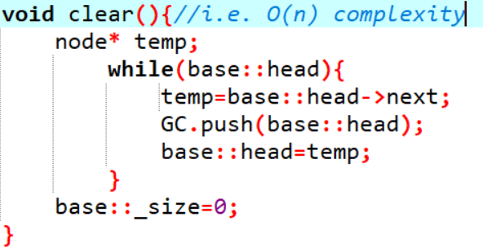
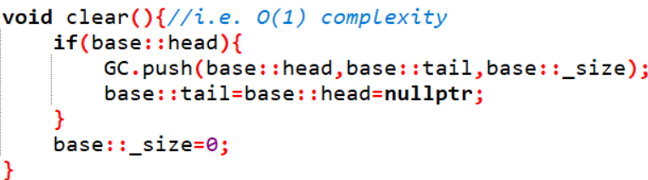
Singly Class Destructor
Doubly Class Destructor

Slide 6
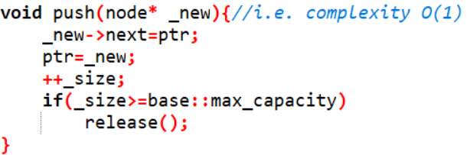
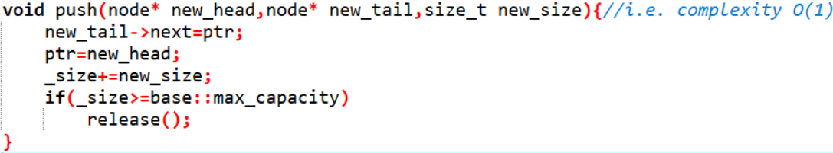
GC push (i.e. for single node)
Note: Same implementation for both SLL & DLL
GC Special Push (i.e. transfer of all DLL nodes)

Slide 7
MULTI ATTRIBUTE TREE ADAPTER

Slide 8
Background:-
Why Needed?
In simple trees (BST/AVL etc), we usually point data of 1 type at a time, but the problem occurs when we need trees for storing structure of multiple attributes.
In such scenario, it can then only give optimized results for one attribute i.e. O(logn) while for rest its O(n) time-complexity
Means we can use comparator for only one attribute at a time

Slide 9
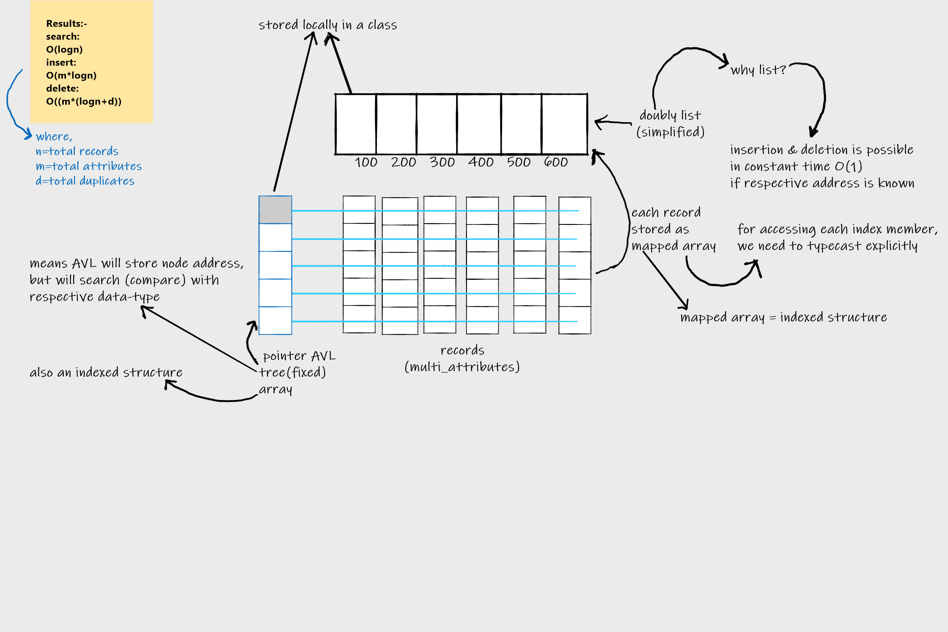
Simplified Concept Diagram

Slide 10
Theoretically similar to:
AVL<Pair<RespectiveType*,List<StorageListNodeType*>>> Trees[TotalAttributes]
Note:
Here, each AVL tree individually points to a specific attribute of record and
also to a list of pointers to the duplicates of that record

Slide 11
INDEXED STRUCT

Slide 12
Background:-
Why Needed?
We can’t store nth attributes in a struct and can’t access them at run-time directly.
Also, we can’t index its attributes, because we might have highly un-aligned structure
(i.e. cannot use some specific offset to access them)

Slide 13
Proposed Concepts (Two Versions):-
Provide Pagination gap of equal size to all attribute blocks on a locally assigned buffer of unsigned char array, using Placement New Operator
Store Offsets of all attributes in an individual static array of optimized offset-type
Additional Perk: you can use 2nd version in-place of normal struct to store
highly un-aligned attributes with much lesser space

Slide 14
THANK YOU!

